Slide 1




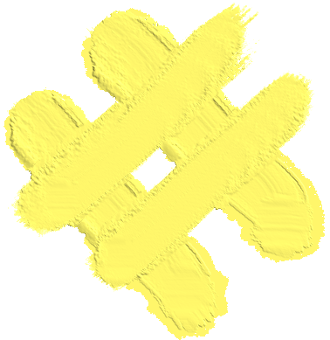

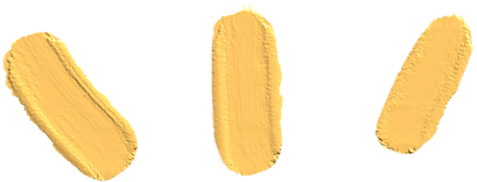












LITTLE SPROUTS
Where young minds grow
An interactive educational resource to teach local ecology and conservation
Houston, We Have a Function
Olive Higbee, Hannah Ostoja, Ian Waak, Gage Ayala
Austin, TX, United States

Slide 2
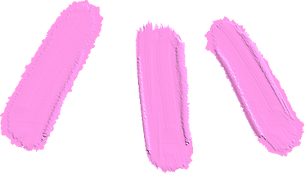
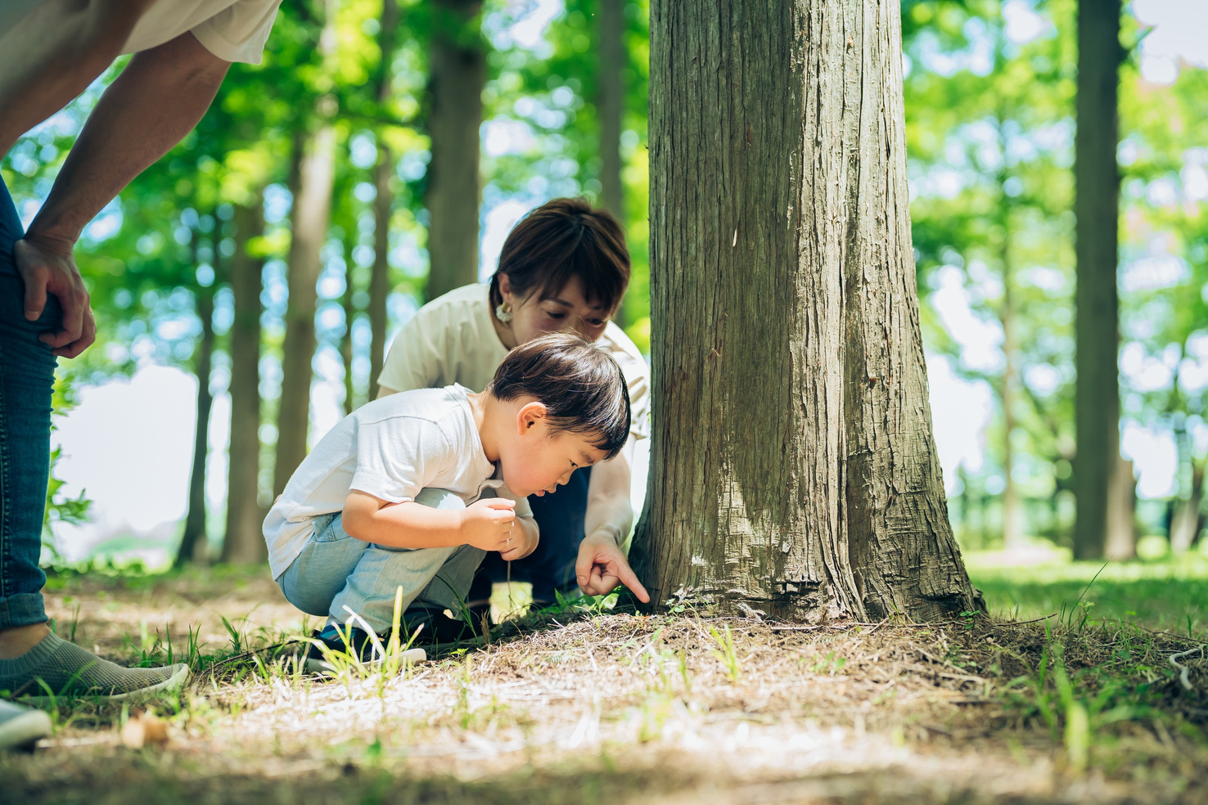


Impact
“There must be provision for the child to have contact with nature; to understand and appreciate the order, the harmony and the beauty in nature.” -Maria Montessori
The world around us is changing. Children in urban areas are increasingly disconnected from natural cycles like flowering and pollination. Educators and community gardens lack easy tools to visualize how plants bloom in their local environments. Little Sprouts empowers teachers with lesson-relevant content and interactive visuals. This inspires students to become future environmental stewards and encourages local action through urban ecology and environmental awareness.
Little Sprouts connects space technology with real-world learning. It engages students with real NASA data and hands-on exploration, building an understanding of phenology, climate, and sustainability. This turns Earth observation data into curiosity, understanding, and care for our youngest minds.

Slide 3


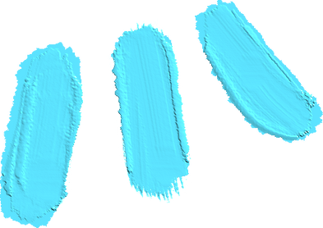


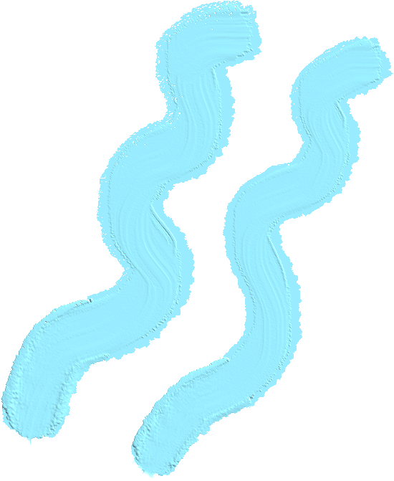


Introducing Little Sprouts
Little Sprouts turns NASA and GLOBE satellite data into an interactive educational site that tracks and visualizes urban plant bloom patterns in real time, inspiring curiosity and conservation.
OBJECTIVES:
Provide educators with an engaging, interactive tool to build a curriculum around local ecology and sustainability.
Engage, inspire, and inform the next generation of our planet’s inhabitants to be conservators of their communities.

Slide 4

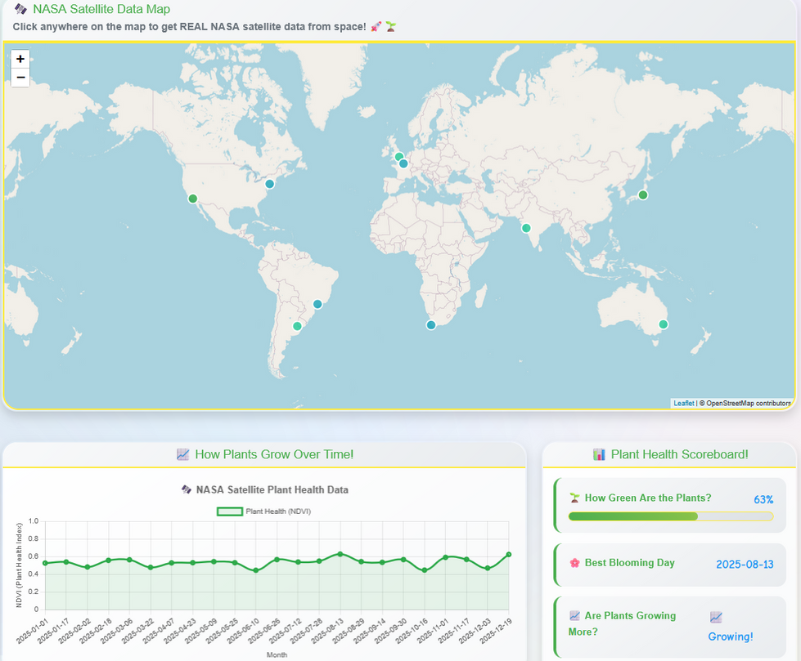


Educational Engagement
Little Sprouts uses NASA Bloom data to display local plant health through an interactive map and graph, educating students of their local ecology with a real-time interactive format. Educators can focus on specific locations and their trends.
Supportive educational materials are provided with Fun Facts and Daily Science Photos, encouraging students’ curiousity on a local and global scale.

Slide 5
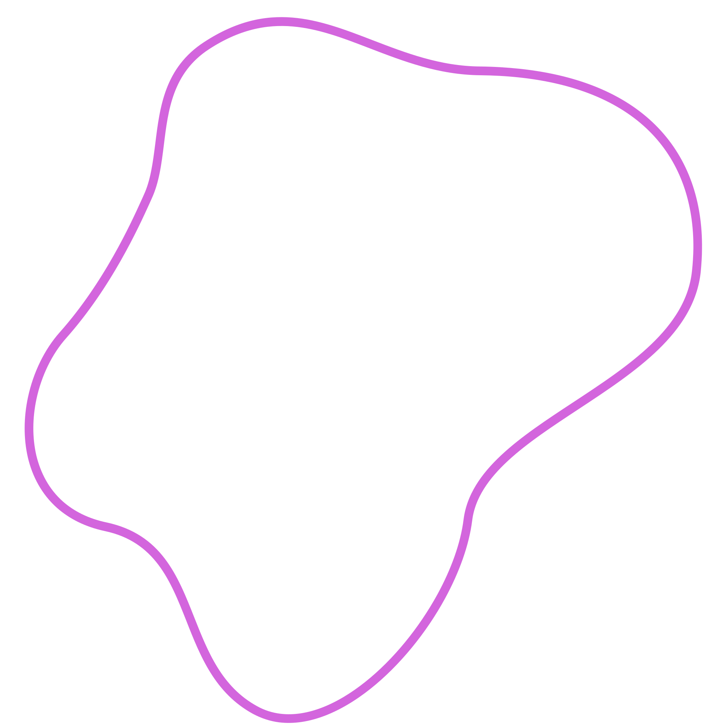
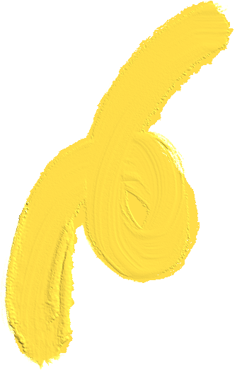

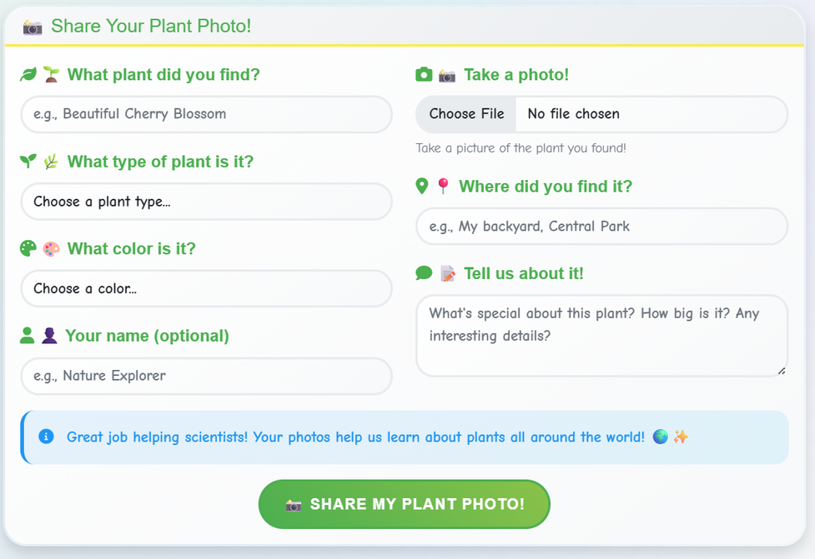
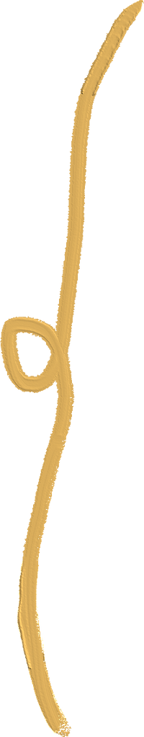

Intergalactic Interactions
Little Sprouts offers fun and engaging opportunities for students to learn. The Kids Quiz Corner tests students knowledge of plant facts, while the games section engage their creative side.
With Citizen Observations, students can report and upload observations of their local flora to Little Sprouts. This encourages children to go outside and observe the world through an environmental lense.

Slide 6




Relevance and Validity
Little Sprouts is the first tool to make NASA Bloom data digestible and interactive for kids and educators. Utilizing real NASA data, this site not only informs students of bloom trends, it actively engages them in the experience. Little Sprouts is powered by:
NASA POWER API: Climate data (temperature, precipitation, solar radiation)
NASA Earthdata: Landsat & MODIS satellite imagery
NASA GIBS: Global satellite imagery visualization
NASA APOD: Astronomy imagery for education
SerpApi: Plant Recipes and Uses, Plant News and Discoveries

Slide 7



Budding Potential
Around the World
Urban Explorers
Global Connection
Level Up!
Expand global bloom trend analytics to cover more locations.
Let students see what plants others have observed in their community with Citizen Observations
Multi-language support for global classroom use.
Bloom Explorer badges to recognize student achievements.

